Slide 1








NICCI
Network-Informed Control – Control-Informed network
Meeting in Aachen 2017
Markus Kögel, Rolf Findeisen
Wireless Cell
RRM

Slide 2
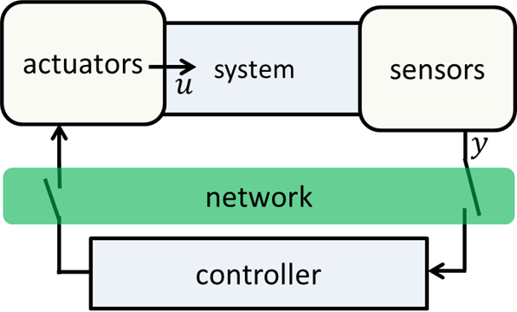
Network aware control Evaluating limits of achievable performance (MD group)
Question – controller optimizes communication for performance ►determine when/what/where to send for optimal performance
Setup
dynamics
unknown, but bounded uncertainties
discrete, time linear dynamics
noisy measurements
network
ideal communication no loss/no (significant) delay (or compensated – data sent arrives before next time instant)
here: one link to sensors/actuators (extension straightforward)
Core idea: exploit robust output feedback MPC
Challenge: when/what/where to send to optimize control performance
Trade-offs: (example)
less latency or more data

Slide 3
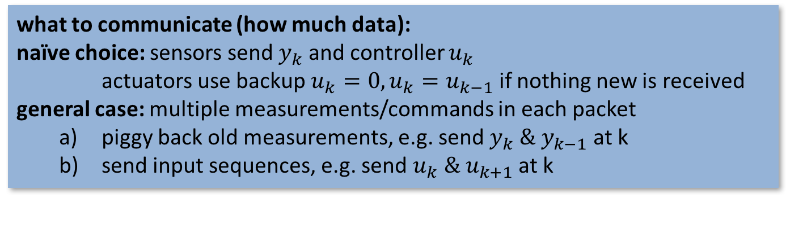




Different communication choices possible (given by RRM)
Possible when/where to communicate formulations
each time instant one communication from sensors or to actuators
on average 0.75 communications each time instant
from sensors/ to actuators
yes
$$no$$
$$time$$
$$k$$
$$k+7$$
what to communicate (how much data):
naïve choice: sensors send $y_{k}$ and controller $u_{k}$ actuators use backup$u_{k}=0, u_{k}=u_{k−1}$if nothing new is received general case: multiple measurements/commands in each packet
piggy back old measurements, e.g. send $y_{k} \& y_{k−1}$ at k
send input sequences, e.g. send $u_{k} \& u_{k+1}$ at k
Solution approach to optimize communication
consider fixed communication schedule tube
simple performance evaluation necessary + avoid influence of tuning

Slide 4
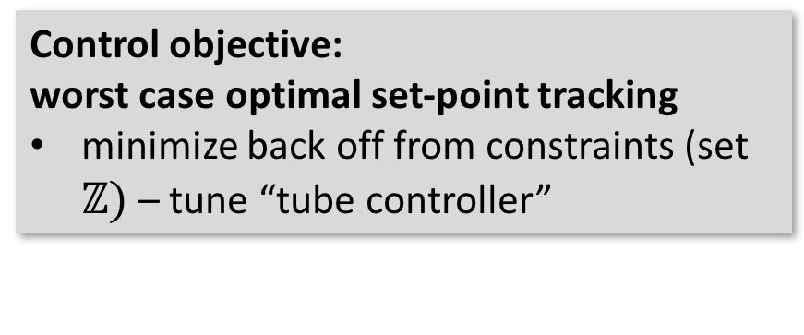

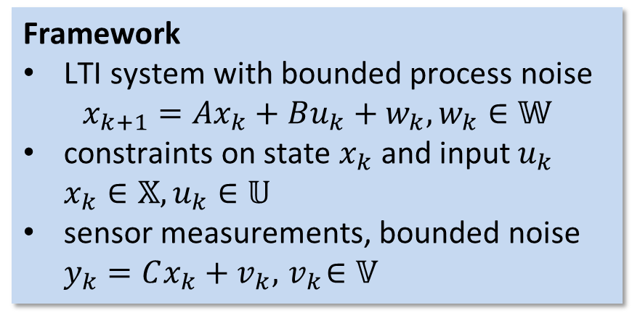


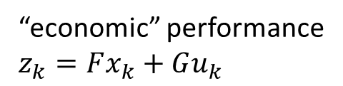
Combination with robust output feedback MPC: basics
“economic” performance
$$z_{k}=Fx_{k}+Gu_{k}$$
Framework
LTI system with bounded process noise $x_{k+1}=Ax_{k}+Bu_{k}+w_{k}, w_{k}∈𝕎$
constraints on state $x_{k}$ and input $u_{k}$ $x_{k}∈𝕏, u_{k}∈𝕌$
sensor measurements, bounded noise $y_{k}=Cx_{k}+v_{k}, { v}_{k}∈𝕍$
$$z_{k}$$
real/tightened constraint
$$ℤ$$
worst case bounds on/nominal dynamics
$$time$$
Robust output feedback MPC:
tube approach: decompose dynamics into
nominal system (no noise) + MPC
error systems + fixed, linear controller
Contribution:
automated “optimal” controller design (for given communication schedule)
allows to compare different communication schedules
guarantees on closed loop behavior (constraint satisfaction, robust stability)
computationally efficient
Control objective:
worst case optimal set-point tracking
minimize back off from constraints (set $ℤ)$– tune “tube controller”

